Slide 1

Angular
Name: XXX

Slide 2
Contents
01
02
03
Introduction
Prerequisites
Dev Env
04
Basics

Slide 3
What is Angular ?
Platform and open-source framework for building Single Page Applications using HTML and Type-script
Developed and maintained by Google
Key features
Component-based architecture
Dependency injection
Two-way data binding
Powerful CLI for development

Slide 4
Version History

Slide 5
AngularJS Vs Angular
Angular JS
Angular
JavaScript
MVC
Two-way
Direct DOM
TypeScript
Component-based
One-way and Two-way
Virtual DOM

Slide 6
Prerequisites
HTML
CSS
Java Script
Type Script

Slide 7
Development Environment
Node
Npm
Angular CLI
VS Code ( or any other text editor )
node -v
npm -v
ng version

Slide 8
How to install Angular CLI ?
To install the latest version
npm install -g @angular/cli
To install specific version
npm install -g @angular/cli@16
To uninstall angular CLI
npm uninstall -a @angular/cli

Slide 9
Basic commands of Angular
Action | Command
Create Application | ng new application_name ng new application_name --no-standalone
Create Module | ng generate module module_name ng g m module_name
Create Component | ng generate component component_name ng g c component_name
Create Service | ng generate service service_name ng g s service_name
Run the Application ( default port 4200 ) | ng serve ng serve --port 4201

Slide 10
How to create an angular project ?
open command prompt or integrated terminal in VS code
change directory to required folder
execute the command
ng new <<project_name>> --no-standalone
ng new my-first-app --no-standalone
cd <<project_name>>
To run the app - ng serve ( http://localhost:4200 )

Slide 11
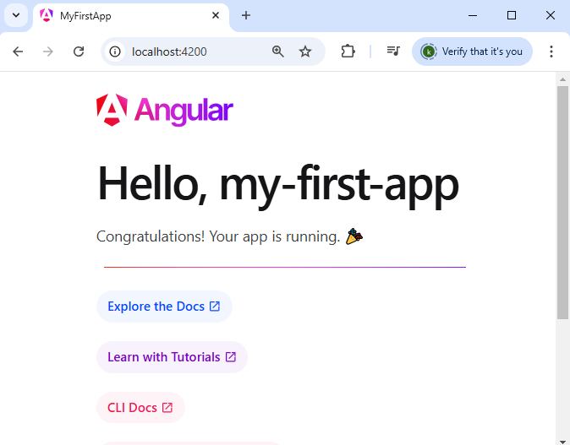

Slide 12
Architecture
Modules
Components
Services

Slide 13
Modules
Represents a feature in your application
A module is essentially a container that groups related components, directives, pipes, and services, making the app easier to manage, scale, and test.
An Angular module is defined using the @NgModule decorator.
Every Angular app has at least one module called the root module (AppModule), which bootstraps the application.
You can create additional feature modules to organize specific areas of the application.

Slide 14
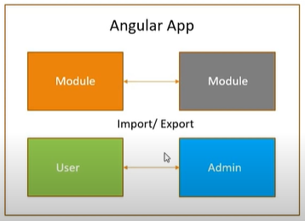
Modules
ng generate module module_name
ng g m module_name

Slide 15
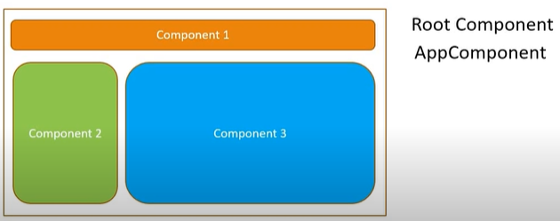
Components
The building blocks of the user interface (UI).
A component controls a specific part of the screen, often referred to as a view
Are responsible for rendering the UI, managing data, and handling user interactions.

Slide 16
Components

Slide 17
What Does a Component Consist Of ?
An Angular component is defined by three main parts:
TypeScript Class: Contains the logic and data for the component.
Template (HTML): Defines the structure and layout of the component's UI.
Styles (CSS/SCSS): Defines the visual appearance of the component.
Components are defined using the @Component decorator.
ng generate component component_name
ng g c component_name

Slide 18
Component - Real world example
In a shopping app, you might have components like:
HeaderComponent: Renders the app's header.
ProductListComponent: Displays a list of products.
ProductDetailComponent: Shows details of a single product.
CartComponent: Displays the user's shopping cart.

Slide 19
Services
Are used to provide shared logic and functionality across different parts of an application.
They encapsulate business logic, data access, or reusable methods, allowing components to focus on rendering the UI and handling user interactions.
ng generate service service_name
ng g s service_name

Slide 20
Key Features of Angular Services
Reusability: Services promote code reuse by centralizing common functionality.
Dependency Injection (DI): Angular provides a built-in DI framework to inject services into components or other services.
Separation of Concerns: Services handle non-UI logic (e.g., data fetching, computations), keeping components focused on the UI.
Singleton by Default: Services are typically singleton instances, meaning the same instance is shared throughout the application.

Slide 21
Why Use Services in Angular ?
Sharing Data: Passing data between components (e.g., user authentication status).
API Communication: Fetching or sending data to a server using HTTP requests.
Utility Functions: Providing reusable logic, such as formatting dates or validating forms.
Encapsulating Business Logic: Implementing complex operations outside of components.

Slide 22
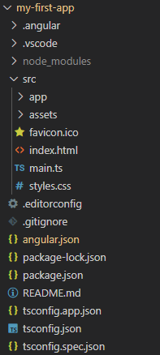
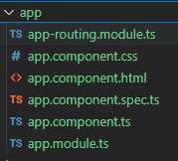
Project Folder Structure and files
main.ts -> app.module.ts -> app.component.ts

Slide 23


How to create a component
right click on app folder and create a new folder,
give the name for the component
Each component will have at least one ts file
Create a new ts file inside the component folder

Slide 24
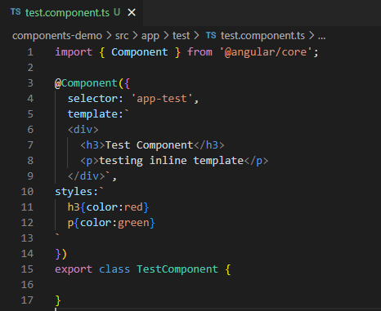
test.component.ts file

Slide 25
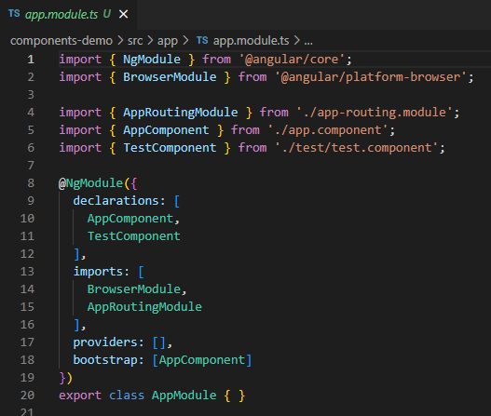
How to use a component
import the component in app.module.ts file
add the component name to the declarations in app.module.ts file

Slide 26
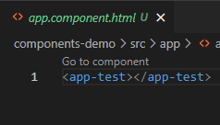
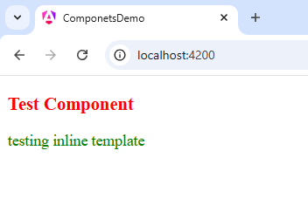
How to use a component
In app.component.html file
output

Slide 27
name = "John";
Data Binding
mechanism that allows communication between the component's class (TypeScript code) and its template (HTML).
connects the data displayed in the user interface (UI) with the business logic of the application, enabling dynamic and interactive web applications
Types
one-way data binding
Interpolation
Property binding
Event binding
two-way data binding
Why ??!!
keeps the view and the data model synchronized
Simplifies UI updates and interactions
Reduces boilerplate code compared to manual DOM manipulation

Slide 28
One-way data binding
From Component to Template
Data flows from the component to the DOM ( html )
interpolation - {{ }}
Used to display dynamic data in the template
ts file
message = “ Hello, Angular!”
html file
<p> {{ message }}</p>

Slide 29
One-way data binding
From Component to Template
Data flows from the component to the DOM ( html )
property binding - [ property ]
Used to bind data to HTML element properties
ts file
imageUrl = "https://example.com/image.png";
html file
<img [src]="imageUrl" />

Slide 30
One-way data binding
From Template to Component
event binding -
Captures user input or DOM events and passes them to the component
ts file
handleClick() {
console.log("Button clicked!");
}
html file
<button (click)="handleClick()">Click Me </button>

Slide 31
Two-way data binding
allows data to flow both from the component to the template and vice versa
It is commonly used in forms where user input needs to update the component's data, and vice versa
ts file
name = "John";
html file
<input [(ngModel)]="name" />
<p>Hello, {{ name }}!</p>

Slide 32
Structural Directives
Structural directives in Angular are directives that modify the structure of the DOM by adding, removing, or manipulating elements dynamically.
They are applied using the * prefix and modify the layout of the page.
Common Structural Directives
*ngIf – Conditionally renders elements.
*ngFor – Iterates over a collection.
*ngSwitch – Displays elements based on a condition.

Slide 33
*ngIf (Conditional Rendering)
The *ngIf directive adds or removes an element based on a boolean condition.
html file
<p *ngIf="isVisible">This text is visible.</p>
ts file
isVisible = true; // If false, the <p> tag will not be rendered
html file
<p *ngIf="isVisible; else noText">This text is visible.</p>
<ng-template #noText><p>Text is hidden.</p></ng-template>

Slide 34
*ngFor (Looping Over Data)
The *ngFor directive iterates over an array and renders elements dynamically.
ts file
items = ['Apple', 'Banana', 'Cherry'];
html file
<ul>
<li *ngFor="let item of items; let i = index">
{{ i + 1 }}. {{ item }}
</li>
</ul>

Slide 35
*ngSwitch (Conditional Rendering with Multiple Cases)
The *ngSwitch directive is used when multiple conditions need to be checked.
ts file
color = 'blue';
html file
<div [ngSwitch]="color">
<p *ngSwitchCase="'red'">Red color selected.</p>
<p *ngSwitchCase="'blue'">Blue color selected.</p>
<p *ngSwitchCase="'green'">Green color selected.</p>
<p *ngSwitchDefault>Unknown color.</p>
</div>

